Slide 1
ORGANELLE-SPECIFIC PROTEIN QUALITY CONTROL SYSTEMS AND PROTEIN MISFOLDING DISEASES

Slide 2
Protein Folding and Quality Control Systems in the Cytosol
Comprises a large number of components.
Upon emerging from the ribosome, nascent polypeptides are protected by chaperones, such
as
nascent-polypeptide-associated complex (NAC), Hsp40,
Hsp70,
prefoldin, and
TCP-1 ring complex (TRiC),
and held in a folding competent state until released from the ribosome.

Slide 3
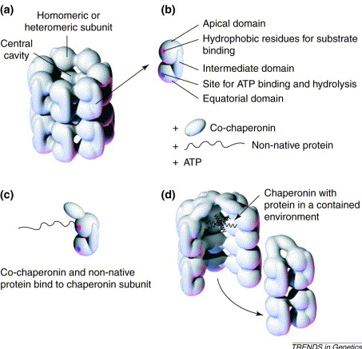
Subsequently, most small proteins complete their folding in the cytosol without assistance, whereas a fraction of the cytosolic proteins requires further assistance from chaperones, e.g., Hsp90 and TRiC .
TRiC, which is the most complex cytosolic chaperone, is composed of a double-ring structure, each with eight different subunits forming a large cavity in which the polypeptide is folded to a native or near-native form, and later released into the cytosol

Slide 4
If the folding to the native structure cannot be completed, the chaperones assess whether misfolded conformers should be refolded or degraded by the ubiquitin-proteasome pathway in order to eliminate toxic conformations.
Targeting a polypeptide for degradation requires a multistep pathway to covalently attach ubiquitin monomers.

Slide 5
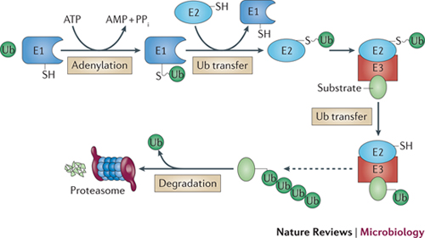
Ubiquitin is activated by the ubiquitin-activating enzyme (E1), and transferred to an ubiquitin carrier protein (E2). The E2 enzyme and the polypeptide both bind to a specific ubiquitin protein ligase (E3), and ubiquitin is covalently attached to the substrate.
Further steps generate a polyubiquitin chain, targeting the polypeptide substrate to the proteasome for degradation

Slide 6
The integrated system of chaperones and the components of the ubiquitin-proteasome pathway comprise the most important cytosolic PQC system.
Failure of the PQC system to degrade misfolded proteins may lead to formation of protein aggregates.
Aggregates in the cytosol may accumulate at a single site called an aggresome, or as soluble monomers and oligomers, which later may precipitate into long amyloid fibrils.

Slide 7
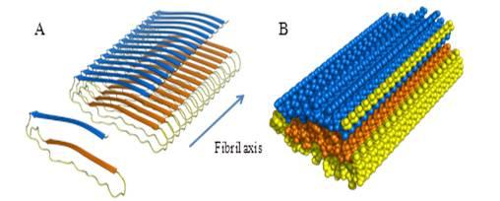
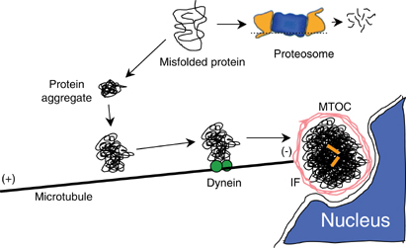
Aggresomes are large globular deposits formed by transport of aggregated material along microtubular tracks in a highly ordered transportation system, whereas amyloid fibrils are long protein aggregates with a tube-like core region formed by the inherent properties of circular
β-sheet structures

Slide 8
Cytosol-Associated Protein Misfolding Diseases (1)
Defective folding caused by amino acid substitutions that result in rapid degradation of the variant protein is exemplified by phenylketonuria (PKU), an inborn error of phenylalanine metabolism.
Amino acid substitutions in the phenylalanine hydroxylase (PAH) enzyme far from the enzyme’s active site may cause misfolding of the protein, hinder formation of the active tetramer, and trigger rapid degradation.

Slide 9
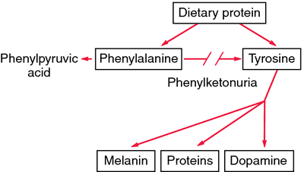
PAH and PKU

Slide 10
In many cases PKU is thus due to loss-of-function pathogenesis.
An increase in the chaperone concentration or lowering of the temperature facilitates the protein folding and, at least in cell models, rescues the enzymatic activity of PAH

Slide 11
Loss-of-function pathogenesis: definition
Pathogenesis resulting from insufficient protein function due to inadequate protein synthesis, functional site amino acid alterations, or inability to achieve the functional protein structure because of misfolding

Slide 12
PKU At A Glance
PKU is a metabolic disorder caused by a deficiency of the liver enzyme phenylalanine hydroxylase. It prevents normal metabolization of

Slide 13
PKU At A Glance
Phe, one of the essential amino acids that cannot be manufactured by the body and must therefore be taken from protein rich foods.

Slide 14
Phe to Tyr Conversion
Individuals with PKU have a deficiency in the enzyme

Slide 15
Phe to Tyr Conversion
phenylalanine hydroxylase, which converts phenylalanine to tyrosine.

Slide 16
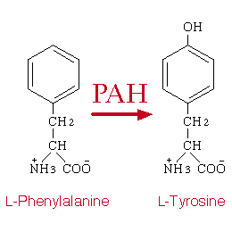
Phe to Tyr Conversion

Slide 17
Metabolic Pathways
In individuals with PKU, phenylalanine can’t be converted into tyrosine, and the metabolic process stops short of producing the needed end products.

Slide 18
PAH and PKU

Slide 19
Metabolic Pathways
Phenylalanine builds up in the body to toxic levels, causing mental retardation.

Slide 20
PKU Treatment
The only treatment available for PKU is a diet where phenylalanine levels are strictly limited.

Slide 21
PKU Prognosis
If the condition was not diagnosed early and a special diet started, the indidivudal will suffer severe and irreversable brain damage.

Slide 22
Cytosol-Associated Protein Misfolding Diseases (2)
A special case of protein misfolding diseases are those caused by variations in the folding machinery itself, leading to reduced PQC efficiency.
One example is desmin-related myopathy, where αB-crystallin, a small heatshock protein, plays a role in the folding of desmin, which has its function in the intermediate filaments of cardiomyocytes.
This function, however, is compromised by a single amino acid substitution that leads to the formation of aggregates containing both desmin and αB-crystallin

Slide 23
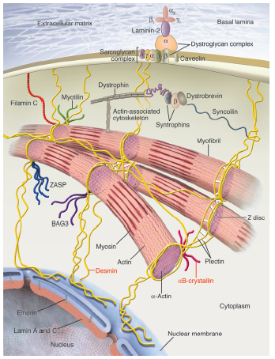
Molecular cytoarchitecture of a myocyte, featuring proteins involved in skeletal and cardiac myopathies.
Desmin is a main muscle protein.
It interacts with other proteins to support myofibrils.
Desmin provides maintenance of cellular integrity, force transmission, and mechano-chemical signaling.
Mutations in other sarcomeric and cytoskeletal proteins (plectin,filamin C, αB-crystallin etc..) cause neuromuscular
disorders

Slide 24
Cytosol-Associated Protein Misfolding Diseases (3)
In Parkinson’s disease (PD), protein aggregates are formed in the brain, leading to neurodegeneration.
Point mutations or increased expression of the α-synuclein gene lead to a dominant form of the familial disease by a toxic gain-of-function pathogenesis due to cytosolic aggregates consisting of either wild-type or variant α-synuclein, as well as components of the ubiquitin-proteasome system.

Slide 25
Definition of Gain-of-function pathogenesis :
The misfolded protein accumulates/ aggregates in the cell, giving rise to new toxic functions related to physico-chemical properties

Slide 26
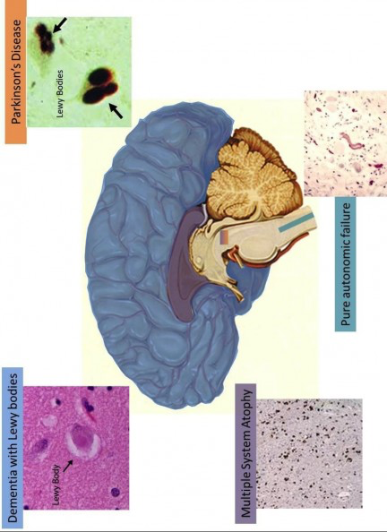
The diversity of synucleinopathies
overview of where different synucleinopathies exist in brain
Parkinson's disease is shown in orange and affects the substantia nigra

Slide 27
Early onset recessive forms of Parkinson’s disease are associated with variations in the PARKIN, UCH-L1, DJ-1, or PINK1 genes.
These genes code for components involved in the ubiquitination and turnover of α-synuclein, and it is speculated that the pathogenesis includes a loss of PQC function, leading to α-synuclein aggregation in addition to general oxidative stress causing mitochondrial dysfunction

Slide 28
Cytosol-Associated Protein Misfolding Diseases (4)
The pathogenesis of amyotrophic lateral sclerosis (ALS) mediated by Cu,Zn superoxide dismutase gene (SOD1) variations is believed to be gain-of function through aggregation of the misfolded variant SOD1 protein.
SOD1 protects the cell from oxidative damage by catalyzing the dismutation of the superoxide radicals to hydrogen peroxide and oxygen

Slide 29
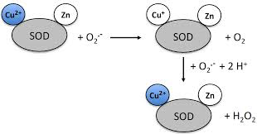
Reaction catalyzed by SOD1
SOD1 catalyzes the dismutation of the superoxide radicals to hydrogen peroxide and oxygen
The disease therefore seems to be a case of increased oxidative damage from enzymatic haploinsufficiency

Slide 30
However, artificial reduction of the enzymatic SOD1 activity does not mimic the ALS phenotype in animal models. In fact, several of the SOD1 variants remain fully active.
More than 100 disease-associated SOD1 gene variations are known, accounting for 25% of the familial ALS cases, which for the most part are transmitted in a dominant fashion.
Several gained functions have been proposed for the variant proteins, such as aberrant chemistry of the Cu and Zn sites, loss of protein function through co-aggregation with the aggregates, depletion of molecular chaperones,
dysfunction of the proteasome overwhelmed with misfolded proteins, as well as disturbance of mitochondrion and peroxisome functions.

Slide 31
A combined gain-of-function and loss-of function may be a more widespread pathogenesis than presently acknowledged, and a dysfunctional effect from accumulation of aberrant proteins may in fact be present in many protein misfolding diseases

Slide 32
Protein Folding and Quality Control in the Endoplasmic Reticulum
Endoplasmic reticulum (ER): first compartment of the secretory pathway. It is engaged with ribosomal protein synthesis, co- and post-translational modification, and protein folding. Proteins enter the organelle in an unfolded state and begin to fold co-translationally.

Slide 33
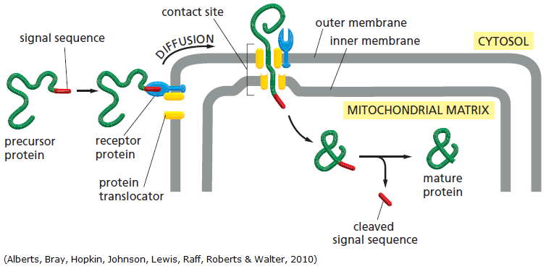
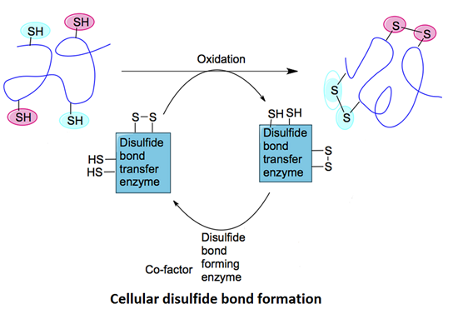
ER lumen contains high concentrations of a specialized set of chaperones and folding enzymes, which assist protein folding in conjunction with post-translational modifications, e.g., signal peptide cleavage, disulfide bond formation, and N-linked glycosylation.
In this respect, the ER plays a crucial role in the PQC, regulating the transport of proteins from the ER to the Golgi apparatus, as only proteins that have attained their native structure in the ER are exported efficiently

Slide 34
Interactions with components of the primary PQC, i.e., BiP, calnexin, calreticulin, glucose-regulated protein Grp94 and the thiol-disulphide oxidoreductases, protein disulphide isomerase (PDI), and ERp57 assist protein folding.
Misfolded or unassembled proteins may accumulate in the absence of efficient ER associated degradation (ERAD)

Slide 35
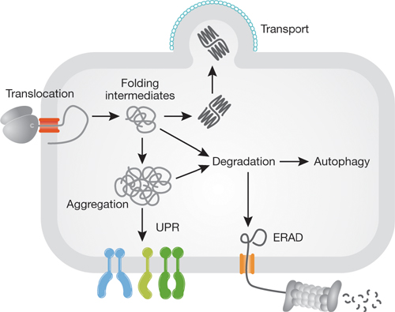
Substrates for ERAD are selected by the PQC system and translocated to the cytosol, where they normally are degraded by the ubiquitin-proteasome system

Slide 36
A substantial number of cellular proteins are processed and transported through the ER. These include receptors and ion channels to be expressed on the cell surface, enzymes and hormones to be secreted, as well as proteins with a specialized function within the organelles of the secretory pathway.
Because many of these proteins are essential and indispensable in many physiological processes, a variety of disease phenotypes may result from impairment of their ER-mediated transport.
Therefore, defective ER processing of proteins may contribute to numerous diseases

Slide 37
Endoplasmic Reticulum–Associated Misfolding Diseases (1)
ER-associated misfolding and rapid degradation by ERAD are hallmarks of cystic fibrosis (CF), which is a lethal autosomal recessive disease caused by mutations in the CF transmembrane conductance regulator (CFTR ) gene encoding a chloride channel.
The disease results from loss of chloride regulation in epithelia expressing the gene

Slide 38
More than 1000 disease-associated CFTR gene variations have been described.
However, one single variation, coding for an one amino acid deletion variant, ΔF508, is the most common, accounting for about 66% of all disease- associated variant CFTR alleles worldwide.
For the ΔF508 CFTR protein the maturation process is very inefficient and virtually all of the protein (>99%) undergoes rapid ERAD

Slide 39
CFTR
Structure & Function

Slide 40
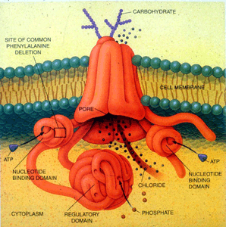
Cystic Fibrosis Transmembrane conductance Regulator (CFTR) is a protein that in humans is encoded by the CFTR gene.
CFTR is an ABC transporter-class ion channel that transports chloride and thiocyanate ions across epithelial cell membranes.
Structure:- CFTR is a glycoprotein with 1480 aa. It consists of five domains.
There are two transmembrane domains, each with six spans of alpha helices. These are each connected to a nucleotide binding domain (NBD) in the cytoplasm.
The first NBD is connected to the second transmembrane domain by a regulatory "R" domain that is a unique feature of CFTR, not present in other ABC transporters.

Slide 41
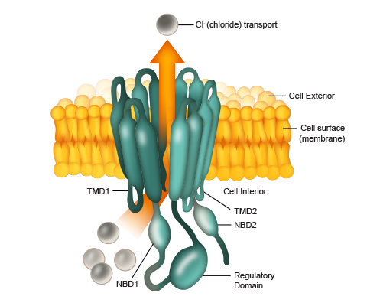
CFTR is composed of five functional domains.
TMDs or ‘transmembrane domains’:
Around 19% of CFTR is composed of TMD1 and TMD2, which form the channel pore allowing transport of chloride ions across the membrane.
NBDs or ‘nucleotide-binding domains’:
These domains bind the nucleotide molecule ATP (a vehicle of chemical energy). Opening and closing of the channel (or ‘gating’) requires ATP to bind to these domains.
Regulatory (‘R’) domain:
The R domain regulates channel activity and can be considered to be the ‘trigger’ governing whether the channel opens or closes, to activate the channel.
Many CF-causing mutations occur in NBD1, including F508del,

Slide 42
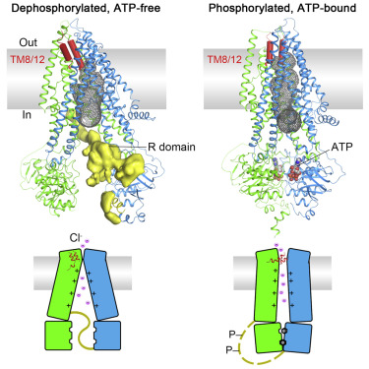
The ion channel only opens when its R-domain has been phosphorylated by PKA and ATP is bound at the NBDs.
The carboxyl terminal of the protein is anchored to the cytoskeleton by a PDZ-interacting domain**.

Slide 43
Function: CFTR functions as a -activated ATP- gated anion channel, increasing the conductance for certain anions (e.g. Cl–) to flow down their electrochemical gradient.
ATP-driven conformational changes in CFTR open and close a gate to allow transmembrane flow of anions.
The CFTR is found in the epithelial cells of many organs including the lung ,liver, pancreas, digestive tract, reproductive tract, and skin. Normally, the protein moves chloride and ions with a negative charge out of an epithelial cell to the covering mucus.

Slide 44
**The PDZ domain is a common structural domain of 80-90 amino-acids found in the signaling proteins of bacteria, yeast, plants, viruses and animals. Proteins containing PDZ domains play a key role in anchoring receptor proteins in the membrane to cytoskeletal components.
PDZ domain structures. (A) PDZ3 of PSD-95 (cyan), complexed with the C-terminal pentapeptide of CRIPT (KQTSV, yellow). (B) The PDZ domain of a-1 syntrophin (green), complexed with the PDZ domain of nNOS (blue). (C) Homodimer of Grip1 PDZ6 (pink and purple), complexed with the C-terminal octapeptide of Liprin (ATVRTYSC, yellow).

Slide 45
Positively charged sodium ions follow these anions out of the cell to maintain electrical balance. This increases the total electrolyte concentration in the mucus, resulting in the movement of water out of cell by osmosis.
Mutation
Well over one thousand mutations have been described that can affect the CFTR gene. Such mutations can cause two genetic disorders, congenital bilateral absence of vas deferens and the more widely known disorder cystic fibrosis.
Both disorders arise from the blockage of the movement of ions and, therefore, water into and out of cells. In congenital bilateral absence of vas deferens, the protein may be still functional but not at normal efficiency, this leads to the production of thick mucus, which blocks the developing vas deferens.

Slide 46
In people with mutations giving rise to cystic fibrosis, the blockage in ion transport occurs in epithelial cells that line the passage ways of the lungs, pancreas, and other organs. This leads to chronic dysfunction, disability, and a reduced life expectancy.
The most common mutation, ΔF508 results from a deletion (Δ) of three nucleotides which results in a loss of the amino acid phenylalanine (F) at the 508th position on the protein. As a result the protein does not fold normally and is more quickly degraded.

Slide 47
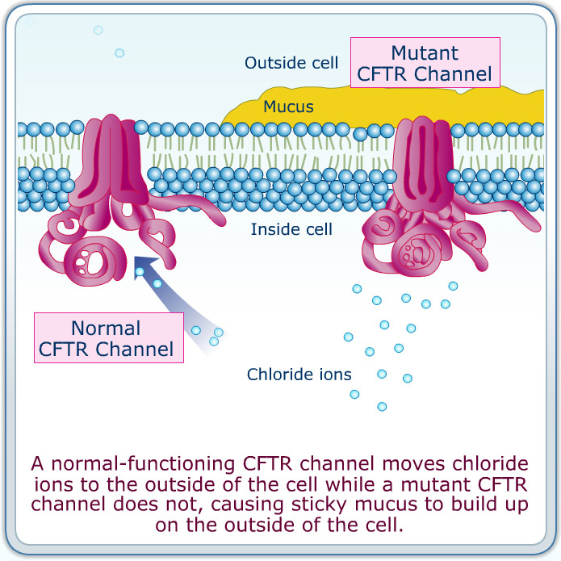

Slide 48
Synthesis of CFTR occurs with its concomitant
insertion in the ER membrane and attachment of Hsc70/Hsp70 to nascent cytosolic domains. The cell seems to use this Hsc70/Hsp70 control as the first checkpoint to assess CFTR conformation, and it has been proposed that it is the major mechanism to discard F508 CFTR.
In contrast, wild-type CFTR proceeds in the folding pathway through interaction of its N-glycosyl residues with calnexin. Subsequently, it acquires its native conformation for ER export through successive rounds of de- and re-glucosylation binding to calnexin.

Slide 49
The cellular fate of CFTR chloride channels is depicted. Wild-type CFTR is transported to the plasma membrane. By contrast, ΔF508-CFTR, the mutant protein present in individuals with cystic fibrosis, is degraded by endoplasmic-reticulum-mediated pathways (ERAD) before it reaches the plasma membrane.

Slide 50
Endoplasmic Reticulum–Associated Misfolding Diseases (2)
Like CF, hereditary emphysema due to α-1-antitrypsin deficiency seems to involve ER associated misfolding and rapid degradation.
α-1-antitrypsin is a major plasma serine protease inhibitor secreted by hepatocytes to regulate the proteolytic activity of various circulating enzymes.
α-1-antitrypsin shows considerable genetic variability, having more than 90 naturally occurring variants

Slide 51
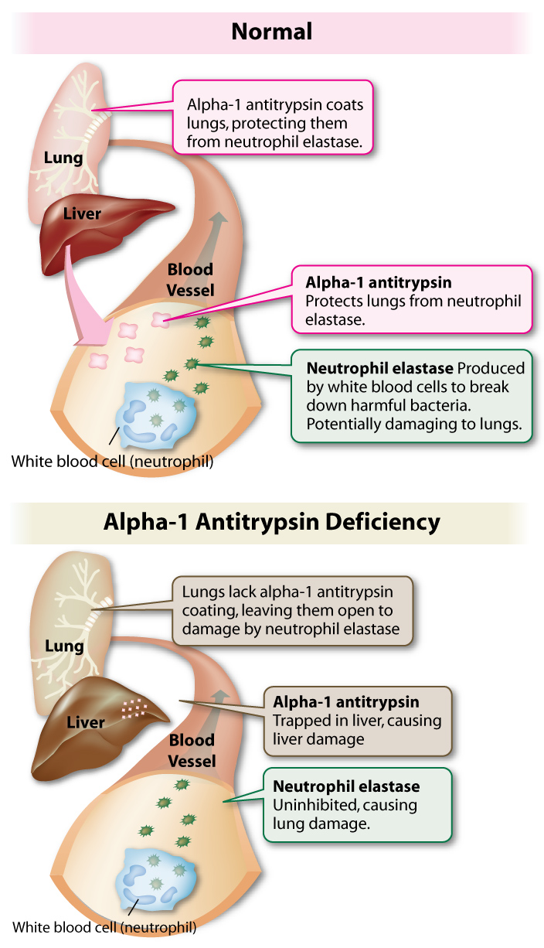
Severe α-1-antitrypsin deficiency affects
approximately 1 in 1800 newborns and 95% of these individuals are homozygous for the E342K allele. E342K homozygotes are predisposed to premature development of pulmonary emphysema in adult life by a loss-of-function mechanism, i.e., lack of α- 1-antitrypsin in the lung leads to proteolytic damage of the connective tissue matrix by neutrophil elastase.

Slide 52
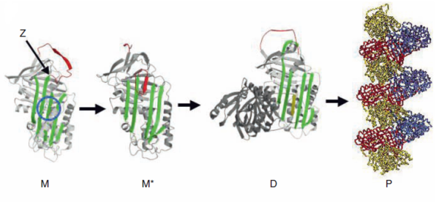
The E342K substitution reduces the stability of the monomeric form of the protein and increases its tendency to form polymers in vitro by the “loop-sheet” insertion mechanism.
The abnormally folded and polymerized E342Kα-1- antitrypsin variant is retained in the ER of hepatocytes rather than being secreted into the circulation, thereby causing plasma deficiency of α-1-antitrypsin

Slide 53
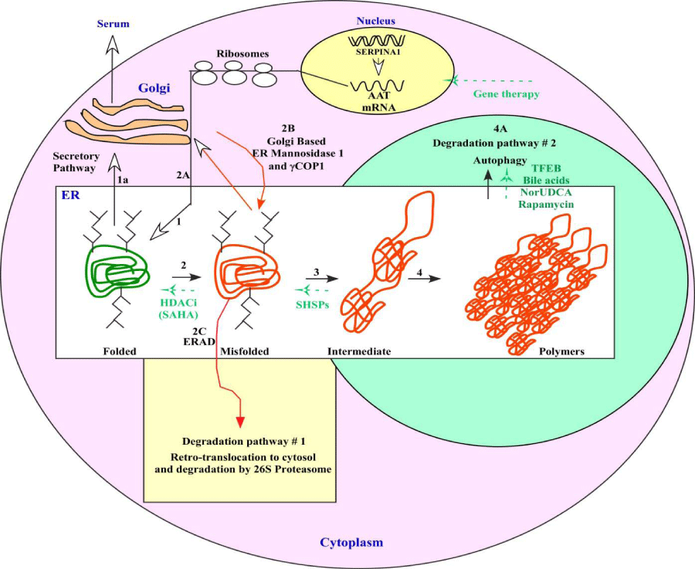
AAT mRNA is transcribed from SERPINA1 gene (gene coding for WTα- 1-antitrypsin) in nucleus and translated to AAT polypeptides sequence. AAT nascent polypetide translocates to the ER, where by cellular proteastasis network folds properly to its native structure and goes through secretory pathway via golgi and secreted to serum.

Slide 54
Point mutation E342K in SERPINA1 gene results in the production of mutated polypeptide that misfolds and retains in ER, or escapes from ER (2A) where they are recognized by golgi based ER Mannosidase 1 and translocated back to ER (2B) for ER Associated Degradation pathway(ERAD; 2C).

Slide 55
Protein Folding and Quality Control in Mitochondria
Mitochondria represent a separate cellular compartment where—in humans— approximately 1500 proteins fold and are degraded.
Only 13 of the mitochondrial proteins are encoded by the mitochondrial DNA, the bulk is nuclear encoded, synthesized in the cytosol and subsequently imported into mitochondria. Import of mitochondrial proteins occurs mainly post-translationally in an unfolded conformation
through pores in the outer and inner mitochondrial
membrane.

Slide 56
Many mitochondrial proteins, especially those of the matrix space, contain amino terminal extensions that counteract premature folding in the cytosol, direct the protein along the mitochondrial import machinery, and are cleaved off upon arrival in the mitochondrial matrix
Molecular chaperones in the cytosol like Hsp70 and Hsp90 keep newly synthesized mitochondrial proteins in an unfolded, import-competent conformation
The mitochondrial PQC system comprises many orthologs to bacterial and yeast PQC systems including molecular chaperones like the mitochondrial Hsp70, the Hsp60/Hsp10 system, and a set of proteases with AAA+ domains that are localized in the matrix or the inner membrane

Slide 57
Mitochondria-Associated Protein Misfolding Diseases
A large number of recessively inherited genetic diseases resulting in loss-of-function due to variations in genes encoding mitochondrial metabolic enzymes have been described.
In many cases, variations are of the missense type and affect the folding propensity of the protein and/or the stability of the native conformation.
A typical example is medium-chain acyl-CoA dehydrogenase (MCAD) deficiency

Slide 58
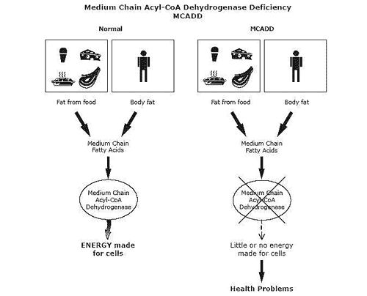
Energy from fat keeps us going whenever our bodies run low of glucose
When the MCAD enzyme is missing or not working well, the body cannot use certain types of fat for energy, and must rely solely on glucose. Although glucose is a good source of energy, there is a limited amount available. Once the glucose has been used up, the body tries to use fat without success. This leads to hypoglycemia, and to the build up of harmful substances in blood.

Slide 59
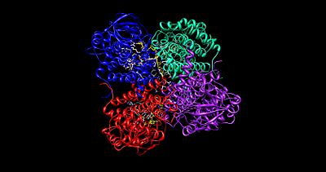
The MCAD enzyme, a homotetramer with FAD as cofactor, is involved in mitochondrial fatty acid β-oxidation.
One prevalent amino acid substitution, K304E, is responsible for approximately
90% of the disease-associated alleles in patients with clinical symptoms.

Slide 60
The K304E variant protein is synthesized and imported into mitochondria at normal levels, but is strongly impaired in folding and assembly. Folding of the MCAD protein occurs through successive interaction with mitochondrial Hsp70 and the mitochondrial chaperone Hsp60.
The K304E variant protein has been shown to remain associated with Hsp60 for prolonged time periods.

Slide 61
An important finding was that the residual level of the natively folded K304E variant enzyme could be strongly modulated by environmental conditions like temperature and availability of chaperones.
Analysis of the K304E variant protein that folded to the
native state after expression under permissive
conditions revealed only slightly altered enzymatic
parameters and a decreased thermal stability.
Similar studies with other disease-causing MCAD variations and other mitochondrial enzyme deficiencies due to missense variations underline that impaired folding is a major effect of disease associated missense variations.

Slide 62
CELLULAR CONSEQUENCES OF PROTEIN MISFOLDING
The effect of gene variations and damaging modifications in a given protein is very complex and variable over time in the same individual or between individuals.
Indeed, gene variations may, in addition to creating an insufficiency of protein function, at certain times, e.g., late in life or under cell stress conditions, give rise to a
gain-of-function pathogenesis due to insufficient elimination of misfolded proteins.

Slide 63
Although the specific biochemistry and cellular pathology—caused by a loss of protein function—is important for diagnosing and treating the individual diseases, the contribution from the cellular disturbances, which are elicited by accumulated and aggregated cellular proteins, may be as important.
It may vary from insignificant to being the determinant
pathogenetic factor, depending on the balance between correct folding, misfolding, degradation, and accumulation of a given variant or damaged protein.

Slide 64
In turn, this balance is determined by the nature of the protein in question, the cellular compartment in which the misfolding occurs, the efficiency of the PQC system, the interacting genetic and chemical factors, as well as the cell and environmental stress conditions

Slide 65
Despite these variables, the cellular consequences—mild or severe—may be discussed within a common framework.
It is possible to distinguish between four levels of cellular reactions.
The first is the immediate reaction and effort of the cell to clear it from misfolded proteins.
The second involves cellular perturbations elicited by noncleared misfolded proteins, which may have assembled into oligomeric and polymeric forms.
The third is the induction of further protection mechanisms against these perturbations, and
The fourth is elimination of the cell.

Slide 66
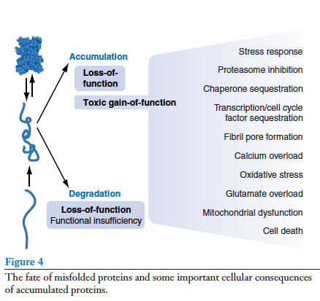
The various mechanisms are not exclusive, but may be interconnected in sequences of events depending on the load of insults as well as other factors, such as type and age of the affected cells.

Slide 67
As discussed before, PQC systems have evolved to protect the cells from unwanted translation products, as well as damaged proteins, all of which may misfold.
If the load of misfolded proteins increases, a set of protective response mechanisms induces the expression of chaperones and proteases, as well as reduces the general protein synthesis to alleviate the load.
In all cases, the mechanisms are governed by an imbalance between occupied chaperones (Hsp70s and Hsp90s) and regulatory proteins

Slide 68
In the young and healthy cell these mechanisms can cope with the load.
But if the misfolded protein is slowly degradable or aggregation prone, or if cell stress is intense and long lasting or the cell has decreased degradation capability , the misfolded protein may accumulate and affect a large number of cellular functions.
The fact that researchers have shown that increased oxidation and impaired protein degradation in old age may result in so-called chaperone overload, strengthen the case.

Slide 69
Another type of pathogenesis leading to cell dysfunction is fibril formation, which has been suggested to account for many of the mechanisms leading to cell dysfunction and death in the traditional neurodegenerative conformational diseases.
Oligomeric misfolded precursors to amyloid plaques have been shown to build into membranes and form pores with devastating consequences for membrane-associated functions, such as ion transport, glutamate homeostasis, oxidative metabolism, and cell viability

Slide 70
A consequence of oxidative stress is the creation of oxidatively modified proteins, which are prone to misfolding and blockage of the degradation systems, most notably the ubiquitin-proteasome system, which will create additional oxidative stress, initiating a vicious cycle.
To suppress the development of cell damage, due in particular to oxidative stress, the cells possess a number of defense systems, which are the antioxidant systems and autophagic system, the functions of which are, respectively, to detoxify ROS and eliminate damaged cell domains.
When the defense systems fail to sustain cell health the final mechanism where all dysfunctions meet is cell death, either as apoptosis or necrosis

Slide 71
SUMMARY POINTS

Slide 72
1. Protein folding is accomplished by intramolecular forces and passes through intermediates with decreasing energy and entropy striving toward an energy minimum.
In vitro, folding intermediates may go off the pathway and use intermolecular forces, resulting in aggregation. In vivo, the folding process is assisted by molecular chaperones, which shield the proteins and guide them to the native structure.

Slide 73
2. Aberration in the amino acid chain, either by inherited gene variations or from damage to amino acids, such as oxidative modifications, may compromise folding, even in the presence of chaperones. Intracellular proteases, which together with the chaperones comprise the cellular protein quality control systems, try to eliminate misfolded proteins.
For certain proteins and under certain circumstances elimination is inefficient and the misfolded protein accumulates as aggregates

Slide 74
3. Aberrant proteins, which are prematurely eliminated by proteases, may give rise to loss-of-function pathogenesis and result in protein deficiency disease. Aberrant proteins, which are not eliminated but accumulated, result in gain-of-function pathogenesis and disease pathology. Some diseases show both loss-of-function and gain-of function pathogenic mechanisms.

Slide 75
4. Typical diseases due to predominantly loss-of-function pathogenesis are phenylketonuria, cystic fibrosis, the pulmonary form of α-1-antitrypsin deficiency, and medium-chain acyl-CoA dehydrogenase deficiency. Typical diseases with predominantly gain-of-function pathogenesis are cardiomyopathies, Parkinson’s disease due to α-synuclein gene variations. Mixed pathogenesis is seen in Parkinson’s disease due to deficiency of the elimination systems, and indicated in short-chain acyl-CoA dehydrogenase deficiency.

Slide 76
5. Diseases with loss-of-function protein misfolding pathogenesis are typically autosomal recessively inherited, such as many metabolic disorders.
In contrast, gain-of function pathogenesis most often results in dominant diseases, either due to “toxic” peptides, such as in keratin and collagen diseases, or due to the cellular effects of the accumulated misfolded protein, such as those seen in Parkinson’s disease with α-synuclein accumulation.

Slide 77
6. The effect of loss-of-function protein misfolding pathogenesis is typically insufficient of a metabolic or transport reaction as well as toxic effects of an accumulated substrate, which is unique for the particular cellular reaction. The effect of accumulated/aggregated proteins is more generally elicited by the physico-chemical properties and not by the specific function of the proteins.

Slide 78
7. Although the effect may be similar for different accumulated proteins, there are probably numerous factors, including cell types affected, which determine the pathology and severity of the insult. In particular, the expression level and the efficiency of the protein quality control systems (PQC) in the specific cell type may be important. This renders aging cells in nondividing tissues, like muscle and brain, especially vulnerable to the consequences of protein misfolding.

