Slide 1
PROTEIN MISFOLDING AND HUMAN DISEASES
How Proteins fold and why they misfold
Role of Molecular Chaperones in Protein Folding
ORGANELLE-SPECIFIC PROTEIN QUALITY CONTROL SYSTEMS AND PROTEIN MISFOLDING DISEASES
Mechanisms and Link to Disease
Molecular chaperones in protein folding and proteostasis
The amyloid state and its association with protein misfolding diseases
Antibodies and protein misfolding: From structural research tools to therapeutic strategies

Slide 2
PROTEIN MISFOLDING DISEASE: GAIN-OF-FUNCTION AND LOSS-OF-FUNCTION DISEASES
Aggregation of Copper–Zinc Superoxide Dismutase in Familial ALS
Protein Misfolding in Alzheimer Disease: The Aβ oligomer hypothesis for synapse failure and memory loss in Alzheimer’s disease
Mechanisms of emphysema in α1-antitrypsin deficiency: molecular and cellular insights
Protein Misfolding and Aggregation in Cataract Disease
Techniques for Monitoring Protein Misfolding and Aggregation in Vitro and in Living Cells
Identifying and validating biomarkers for Alzheimer’s disease

Slide 3
Protein folding and misfolding

Slide 4
INTRODUCTION
The function of most cellular proteins is dependent on their three-dimensional structure, which is acquired through folding of the polypeptide chain coded from the nuclear genome.
Changes in the polypeptide chain, either resulting from inherited or acquired gene variations or from abnormal amino acid modifications, may change the folding process and give rise to misfolding of the protein.

Slide 5
Depending on the nature of the protein itself, the cellular compartment in which the misfolding occurs, the activity of the folding and degradation machineries as well as interacting genetic factors and the cell and environmental conditions, the consequences of the misfolding may be quite different

Slide 6
However, despite this diversity, a large number of very different diseases, from early-onset inborn errors of metabolism to late-onset neurodegenerative diseases, can be viewed as protein misfolding diseases, often called conformational diseases.
On this basis, a common framework related to the molecular pathogenesis and cell pathologic mechanisms in these very different diseases is emerging.

Slide 7
Aims of these lessons
We introduce the theory of protein folding and misfolding in general and mention the emerging ways to predict consequences of amino acid alterations
We introduce the concept of protein quality control (PQC) and discuss the various compartment specific PQC systems as well as the molecular pathogenesis of some representative misfolding diseases originating in the various compartments.

Slide 8
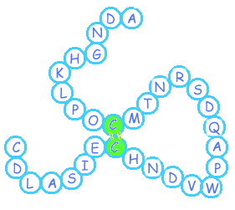
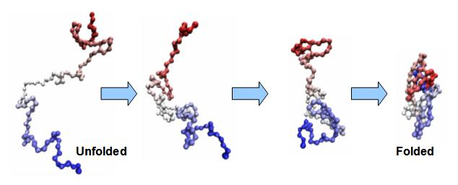
General facts on protein folding
Important elements for protein folding:
The amino acid sequence
The right cellular environment
The perfect balance between the various folding states
A fully functional Protein Quality Control (PQC) system
(T ,P ,pH , etc…)
(Chaperones, proteasome unit )

Slide 9
Causes of misfolding and protein aggregation
How protein aggregates form?
Change in cellular conditions → more misfolded proteins → the PQC system is overwhelmed → aggregation is favored
Aggregation is thought to be set in by protein segments containing hydrophobic amino acids residues, β-sheet predisposition and low net charge.

Slide 10
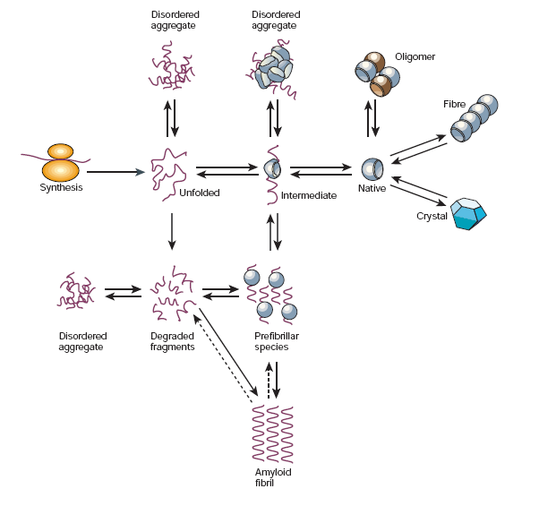
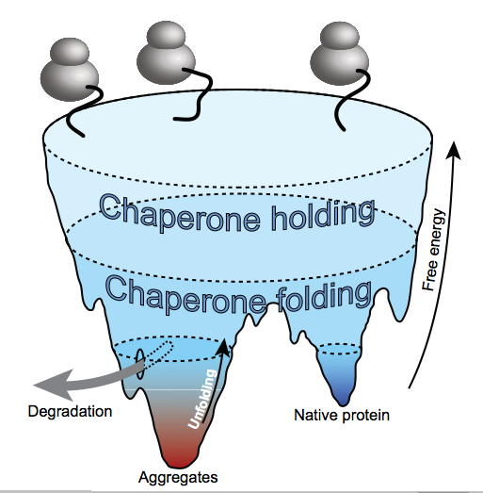
Causes of misfolding and protein aggregation
States accessible to a protein molecule
Free-energy folding landscape for chaperone-mediated protein folding

Slide 11
Causes of misfolding and protein aggregation
Protein aggregation is a 2-stage event
The nucleation → proteins start attaching reversibly to a growing nucleus
Proteins attach irreversibly to the nucleus until it becomes a larger aggregate.

Slide 12
Cellular consequences of protein aggregation
Loss-of-function pathogenesis: if misfolded proteins are prematurely degraded by PQC system
→ protein deficiency disease
Gain-of-function pathogenesis: if misfolded proteins are not eliminated but accumulated instead
→ disease pathology
→ toxicity
Some diseases display both pathogenic mechanisms.
Notes:
protein deficiency disease : not enough active proteins in the cell
toxicity : aggregated become poisonous to the cell

Slide 13
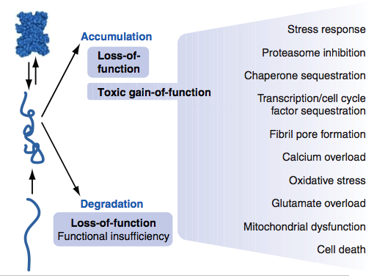
Cellular consequences of protein aggregation
+
the slowing down of polypeptides translation

Slide 14
Protein-misfolding diseases
Include conditions where a protein:
fails to fold correctly (cystic fibrosis, Marfan syndrome, amyotrophic lateral sclerosis)
is not stable enough to perform its normal function (many forms of cancer)
fails to be correctly trafficked (familial hypercholesterolemia, α1-antitrypsin deficiency)
forms insoluble aggregates that deposit toxically (neurodegenerative diseases: Alzheimer’s, type II diabetes, Parkinson’s and many more)

Slide 15
The fundamental mechanism of protein folding
The concept of an energy landscape

Slide 16
Protein Folding

Slide 22
Protein folding models
As Anfinsen showed the amino acid sequence of a polypeptide chain contains all necessary information determining the three-dimensional functional structure of a given protein.
This means that the native state has to be thermodynamically stable and the protein must rapidly find the native state.
If a protein searches through all possible conformations in a random fashion until it finds the conformation with the lowest free energy it will take an enormous amount of time.

Slide 23
Imagine a polypeptide chain with 100 residues and every residue has 2 possible conformations. The protein has 2¹⁰⁰ (or 10³⁰ ) possible conformations, and if it converts one conformation into another in the shortest possible time (maybe 10⁻¹¹ s) the time required is 10¹¹ years.
A protein however reaches its native fold in 10⁻³ to 10³ s both in vitro and in vivo.
The Levinthal paradox states that a random search for the final conformation would take millions of years

Slide 24
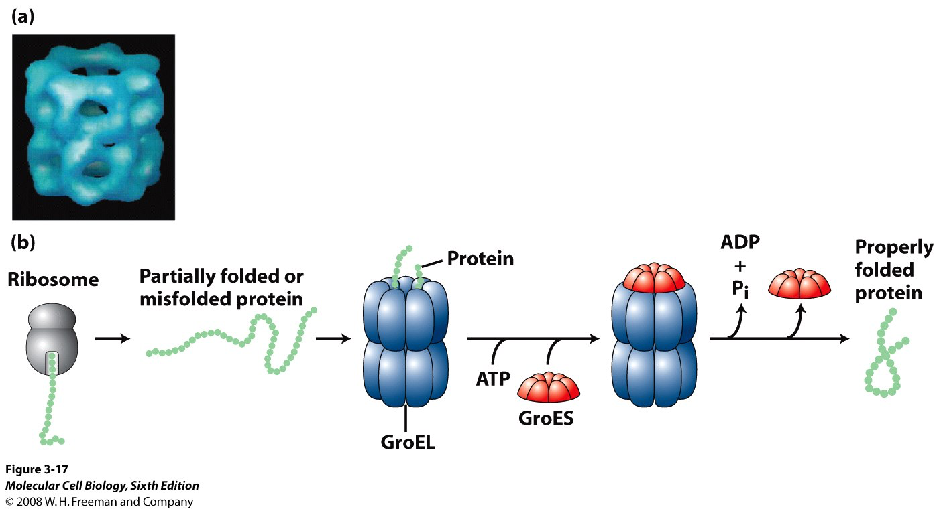
To overcome this obstacle, nature uses a number of biochemical “rules” and has evolved some assisting components facilitating the folding processes, the so-called molecular chaperones (see later)

Slide 25
Molecular chaperones assist the folding by protecting the protein during the folding process and keeping it away from misfolding, which may lead to aggregation (see later).
The target for chaperones is unfolded and partially folded polypeptide chains with exposed stretches of hydrophobic amino acids that are usually inside in the core of folded proteins.
Proteins with exposed hydrophobic stretches are reversibly bound to and released from the chaperones. Many chaperones have an ATPase domain that orchestrates conformational changes, switching the molecule between high and low binding affinity states

Slide 27
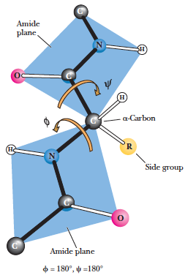
ϕ and ψangles
The planarity of the peptide bond means that there are only two degrees of freedom per residue for the peptide chain. Rotation is allowed about the bond linking the α-carbon and the carbon of the peptide bond and also about the bond linking the nitrogen of the peptide bond and the adjacent α-carbon.
The angle about the Cα-N bond is denoted by the Greek letter ϕ (phi), and that about the Cα-C is denoted by ψ (psi).

Slide 28
The driving force of protein folding is the search for a conformation with lower free energy than the previous one.
The various lower energy states can be separated by barriers of higher energy, and to overcome these barriers chaperone assistance may be required.
Biophysical measurements and computer simulations have revealed that many of the local elements of protein structures can be generated very rapidly; for example, individual α-helices are able to form in less than 100 ns, and β-turns in as little as 1 μs .
Indeed, the folding in vitro of some of the simplest proteins, is completed in less than 50 μs

Slide 29
A certain hierarchy of interactions seems to exist between residues for the first part of the folding process, the so-called nucleation- condensation process, which speeds up the folding through a number of transition states characterized by the presence of interatomic interactions also present in the native protein

Slide 30
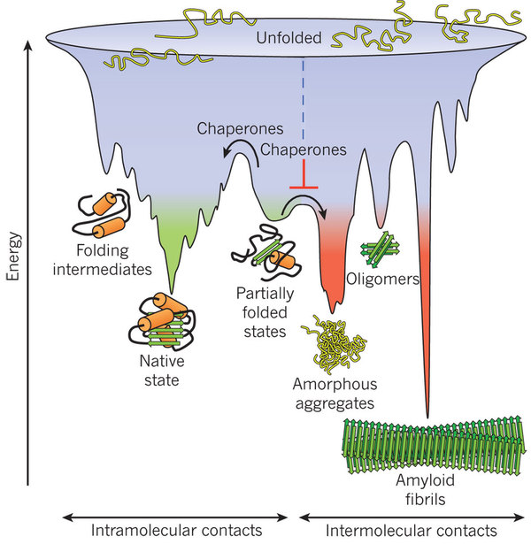
To picture protein folding it has been suggested a topological landscape representing different energy levels
In this model the process of folding is described as a constant striving toward minimal free energy with the native structure of the protein being the conformation with the lowest energy level, the global minimum of the landscape

Slide 31
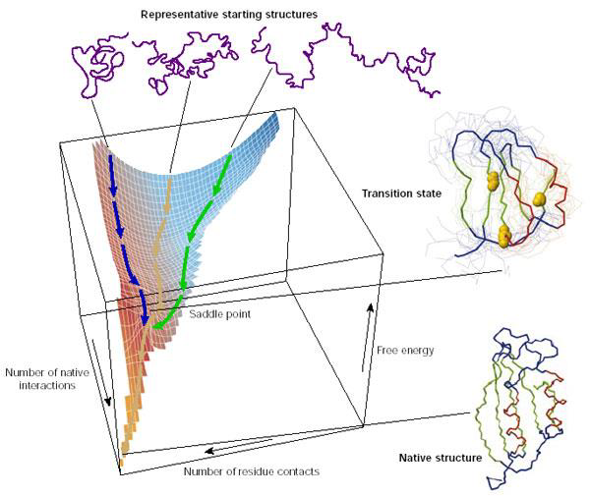
The landscape is drawn as a funnel shape in a three-dimensional system with the free energy on the y axis and the conformational space or entropy as a two-dimensional projection on the x and z axes.

Slide 32
Because the free energy of a protein is a function of its conformation defined by the interactions between the amino acid residues, even small alterations in the amino acid chain may change the surface of the landscape, leading to the possible formation of new local free energy minima resulting in a different stable structure of the protein, which may be prone to aggregation.

Slide 33
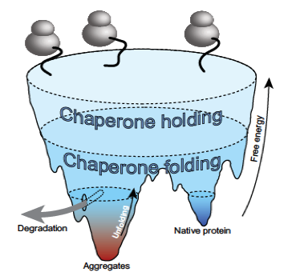
To refine the concept of energy folding landscapes to include the aggregation tendency, which may be aggravated by extrinsic factors, such as high protein concentration and elevated temperature, in the living cell, one can imagine a landscape with two deep valleys

Slide 34
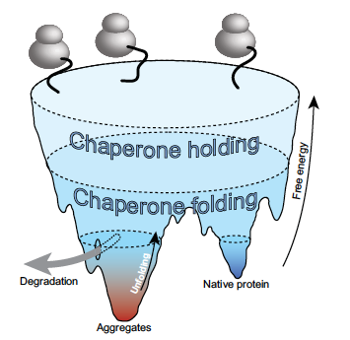
Free-energy folding landscape for chaperone-mediated protein folding:
hypothetical landscape of all possible protein conformations pictured with
higher altitude symbolizing higher free energy and entropy.
Chaperones iteratively bind and release their substrates, each time raising
the free energy and enabling escapes from wrong folding pathways, indicated by the “Unfolding” arrow. Eliminating protein by degradation occurs mainly in areas with trapped misfolding

Slide 35
Energy landscapes can have many different shapes and have many “hills” which represents the high energy conformations that sometimes has to be passed to reach the native state.
Protein aggregates can be extremely stable, even more stable than the native protein, suggesting that the aggregated states are trapped in the kinetically deepest valleys of the landscape.

Slide 36
PROTEIN QUALITY CONTROL SYSTEMS
In the test tube, protein folding is performed most efficiently at low protein concentrations and low temperature.
In contrast, protein folding in human cells takes place at 37◦C—or higher during fever—with very high concentrations of proteins.
To sustain a reasonable efficiency of protein folding in this challenging environment and to protect against
the negative consequences of environmental changes, PQC systems have evolved that supervise folding, counteract aggregation, and eliminate misfolded and damaged polypeptide chains before they can exert toxic effects.

Slide 37
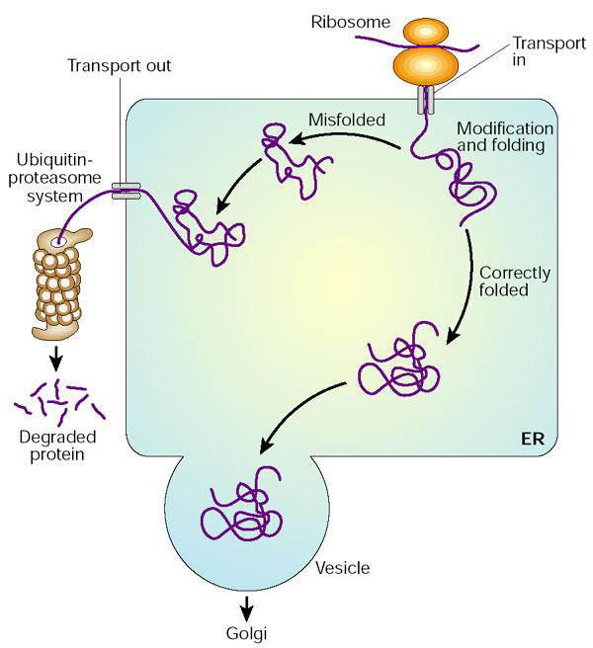
Quality control mechanism
Regulation of protein folding in the ER.
Many newly synthesized proteins are translocated into the ER, where they fold into their three-dimensional structures
with the help of a series of molecular chaperones and folding catalysts (not shown).
Correctly folded proteins are then transported to the Golgi complex and then delivered to the extracellular environment.
However, incorrectly folded proteins are detected by a quality-control mechanism and sent along another pathway (the unfolded protein response) in which they are ubiquitinated and then degraded in the cytoplasm by proteasomes

Slide 38
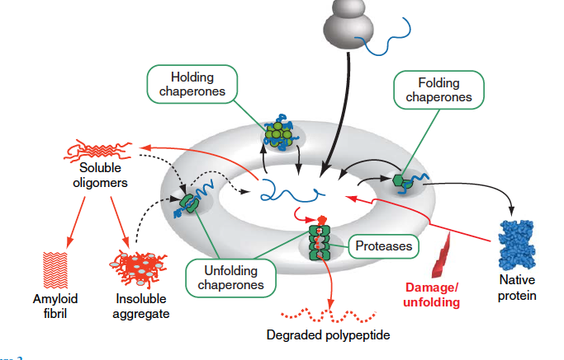
Important components of these systems are comprised by molecular chaperones.
Additionally, the PQC systems contain specialized intracellular proteases and accessory factors that regulate the activity of chaperones and proteases or provide communication between the various components.

Slide 39
Folding, holding and unfolding chaperones
Although there is some overlap and certain chaperones are able to fulfill several functions, one can distinguish between
folding chaperones, holding chaperones, and unfolding chaperones.
Folding chaperones promote folding, whereas holding chaperones, like the small heat-shock proteins lacking an ATPase activity, reversibly bind misfolded proteins. They need to transfer their substrates to folding chaperones to accomplish folding.
Unfolding chaperones typically contain one or two so-called AAA+ domains that harbor an ATPase, and are able to unfold misfolded proteins, either for degradation or to give them a new start for folding

Slide 40
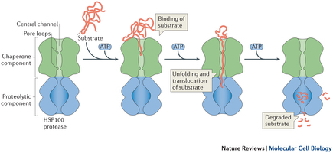
Proteases of PQC systems
The proteases of PQC systems have a particular structure secluding the proteolytically active sites inside cavities that are not accessible for folded proteins
To be degraded, proteins must first be fully unfolded before they are injected into the proteolytic cavities, where they are processively degraded into small peptides. This is typically accomplished by AAA+ domain containing unfolding chaperones.

Slide 41
Functioning of protein quality control (PQC) systems.
PQC systems manage the pool of unfolded and partially folded conformations (center).
Folding chaperones promote folding, holding chaperones maintain solubility, and unfolding chaperones disaggregate aggregates or unfold misfolded proteins and
inject them into proteolytic chambers of PQC proteases

Slide 42
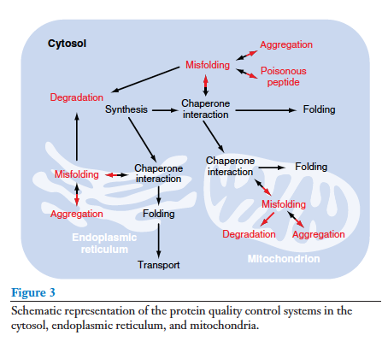
The compartmentation of the cellular PQC systems

